Slide 1
Responsive enterprise mobile development
Day 1

Slide 2
intro
Notes:
We assigned 20 minutes to this topic.

Slide 3
intro
Admin
Parking Lot
Notes:
Admin should include:
This is a beta class. We’re inventing this course out of nothing. We had no other course to base it on. It is going to be rough. I am going to need your help to improve the class for the next people who take it. So fill out your evaluation forms as we go along.
How you want to keep track of how long you talk about each topic.

Slide 4
intro
Here’s what we are starting with:
What this course is
What it isn’t
What we aim to cover
Where we aim for you to be by Friday
Notes:
Show the wires
Show the app
Talk about the reasons for covering jQuery over one of the compact frameworks
Talk about choosing Backbone over one of the others

Slide 5
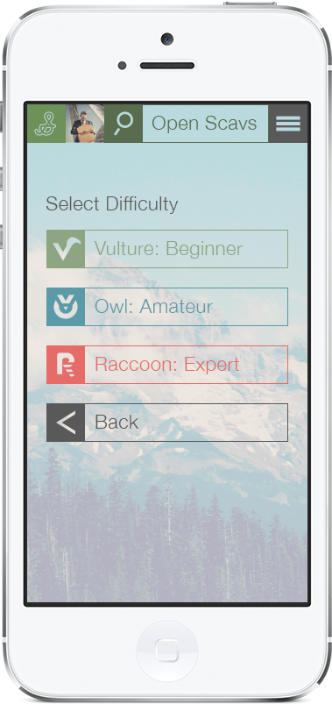


The thing you guys are gonna build
Scav = slang for “Scavenger hunt”
hn = hunt
Notes:
DEMO

Slide 6
On the dance card for today
Architecture: The Case for Hybrid and Alternatives
C# to Objective-C Mind Mapping
IDE Walkthroughs:
AppCode
WebStorm
Android Studio
Xcode5
Cross-Platform Hybrid “Hello World” for iOS and Android
MV* Patterns: C# to Objective-C
Source Control

Slide 7

Architecture
Notes:
We assigned 60 minutes to this topic.

Slide 8
Architecture: hybrid
The case for hybrid
Easy choice for the cross-platform problem
Truly Responsive & platform agnostic. Consistent UX on all platforms.
Target mobile, desktop, embedded, whatever.
It’s free
Easier to get resources with the skills to get it going
Notes:
We assigned 60 minutes to this topic.

Slide 9
Architecture: Hybrid
The problem with hybrid
“Yes. you’re right. Not very delightful.”
Building out the scaffolding can be monumental effort up front
Performance suffers when working with large datasets
Notes:
We assigned 60 minutes to this topic.

Slide 10
Architecture: shrinkwrap hybrid
PhoneGap/Titanium/SenchaTouch
Codiqa
jQueryMobile for the UI
Great for throwing together quick prototypes to prove out an app or UI idea
Can work for Prod, as long as you know, DEFINITIVELY, that the business will never need to covert to native
Most of them cost cash money
Notes:
We assigned 60 minutes to this topic.
https://codiqa.com

Slide 11
Architecture: MVWhatever
Assess the problem.
They are not all equal. Choose the one that best suits itself to the problem and the situation.
Community Support?
Collaboration Support?
Notes:
http://stackoverflow.com/questions/14505016/angularjs-or-backbone-js
http://www.martywong.com/blog/backbone-vs-ember-vs-angular-vs-knockout-review
http://stackoverflow.com/questions/5112899/knockout-js-vs-backbone-js
http://jsperf.com/angular-vs-backbone-vs-knockout-vs-avalon/5
TALK ABOUT DURANDAL
http://durandaljs.com

Slide 12
Architecture: Native
The case for native
VERY delightful
Much quicker to bootstrap
Much easier to build out UI and platform-specific UX
Notes:
We assigned 60 minutes to this topic.

Slide 13
Architecture: Native
The case for native
Better hardware access (camera, geo, video, audio
Much more performant, better capable to deal with large datasets
Little or no dependence on 3rd party frameworks/libraries
Minimal cost up front to get going
Notes:
We assigned 60 minutes to this topic.

Slide 14
Architecture: Native
The problem with native
No cross-platform support. Little or no options for sharing code across platforms
iOS/Android/Windows Phone/Desktop = 3 or 4 separate codebases all written to do the same thing
Tougher resource and infrastructure problem
Notes:
We assigned 60 minutes to this topic.

Slide 15
Architecture: xamarin
The case for Xamarin
What exactly is it?
Notes:
We assigned 60 minutes to this topic.

Slide 16
Architecture: xamarin
The case for Xamarin
Every point made for native works for Xamarin. It’s native.
Supports the ability to write a cross-platform app from a single codebase
It’s .NET. You already know how to build it.
Releases are lock-step with iOS releases. Don’t appear to be going anywhere.
Notes:
We assigned 60 minutes to this topic.

Slide 17
Architecture: xamarin
The problem with Xamarin
It’s expensive
Still a highly specialized skill, which will limit opportunity
It’s a black box. You are at the mercy of Xamarin
Fairly mature, but not without its problems
Notes:
We assigned 60 minutes to this topic.

Slide 18
THE HYBRID STACK
HTML / CSS
HTML5
SASS / COMPASS
LIVE EDIT
JAVASCRIPT
JASMINE
REQUIREJS
SINONJS
BACKBONE / UNDERSCORE
ZEPTOJS
KARMA
JQUERY
ANGULARJS
KNOCKOUT
PHANTOMJS
iOS - OBJECTIVE-C
UIWEBVIEW
OBJ-C MOCKS
AFNETWORKING
XCTEST
CORE DATA
TYPHOON

Slide 19





Tools for the stack
HTML / CSS
Safari
JetBrains WebStorm
Chrome
JAVASCRIPT
Safari
JetBrains WebStorm
Chrome
iOS - OBJECTIVE-C
Xcode 5
JetBrains AppCode

Slide 20

Getting from visual studio to AppCode
Notes:
We assigned 30 minutes to this topic.

Slide 21
Visual studio => AppCode
What you’ll want to use it for
Lay of the land
Keymaps
Debugging
Notes:
Please be sure to say that JetBrains gave us free licenses for AppCode and WebStorm, for education use *only*. They describe using it for anything else as a “severe violation” of the license. We are glad they gave us free educational licenses, so don’t use them for anything else.
What you can do with it – everything but UI, CD Entity Design, etc… don’t want to use Instruments in there, will explain later
Walkthrough of flyouts
Keymaps
Walkthrough of debugger
REST Tool
Walkthrough of test runner

Slide 22

Getting from ReSharper to AppCode
Notes:
We assigned 30 minutes to this topic.

Slide 23
ReSharper => AppCode
Code & autogen
Shortcuts
Refactoring
Notes:
For refactoring: Renaming, change signature

Slide 24
Getting from visual studio to Xcode 5
Notes:
We assigned 50 minutes to this topic.

Slide 25
Visual studio => Xcode 5
What you’ll want to use it for
Lay of the land
Debugging
Notes:
For “what you’ll want to use it for”, don’t forget to show IB and the Core Data Entity Designer

Slide 26
Getting from visual studio to webstorm
Notes:
We assigned 50 minutes to this topic.

Slide 27
Visual studio => webstorm
What you’ll want to use it for
Lay of the land
Debugging

Slide 28
Getting from C# to objective-c
( ){ } == [ ]{ }
Notes:
We assigned 70 minutes to this topic. Figure 35-40 min for this, then cover javascript

Slide 29

C# => objective-c
The History of the World
C#
Objective - C
Notes:
History:
How many know about C# ? History : On to Obj-C

Slide 30

C#
This Dude.
Worked at Borland on Pascal and Delphi
Initially written with “Simple Managed C”
Originally code-named “Cool”
The Clone Wars
2.0: Generics
LINQ! LAMBDAS!
Type-a-teria
Notes:
C#
---
Originally written using a managed code compiler sys called “Simple Managed C”
In ’99, dude named Anders Hejlsberg was tasked to write a new language code-named “Cool”
Also worked on J++ (was one of his first projects
He works on Type
Worked on Turbo Pascal, Embarcadero Delphi. Stated the need to create C# arose from flaws he saw in other languages
Bill Joy and James Gosling accused that C# was a clone of Java. Anders maintained that it was “much closer to C++” in its design
With 2.0, things began to diverge from Java – Generics, for example, are quite a bit different. C# generics are baked in to compiler, with Java it was more of a syntax thing\
Diverged significantly in recent years, primarily through the addition of LINQ and LAMBDAs, anonymous types, Extension methods (will be talking about in a bit – Ems == Categories)
THINGS YOU WILL LOSE
Can do all sorts of things with types
Dependency injection (I’m preparing you for all of the things you are about to lose)

Slide 31

Objective-c
This Dude.
First cut of Obj-C while at Stepstone
Initially written as a C preprocessor
Originally OOPC (OO Pre-Compiler)
Licensed by Jobs & NeXT in 1988
Extended the GCC to support Obj-C,
Added AppKit/FoundationKit for UI
Notes:
Objective-C
---
Brad Cox, worked with another dude named Tom Love

Slide 32
Fundamental Diffs
[Messages], not “Calls”
.h & .m
Colon-separated methods
Id types == Generics (sorta)
Predicates == LINQ/LAMBDA (sorta)
Types…
Notes:
MESSAGES
Sending the message method to the object pointed to by the pointer obj would require the following code in C++:
obj->method(argument);
In Objective-C, this is written as follows:
[obj method:argument];
Talk about variable args:
http://www.numbergrinder.com/2008/12/variable-arguments-varargs-in-objective-c/
NSInvocation:
http://www.informit.com/articles/article.aspx?p=1620076&seqNum=3

Slide 33
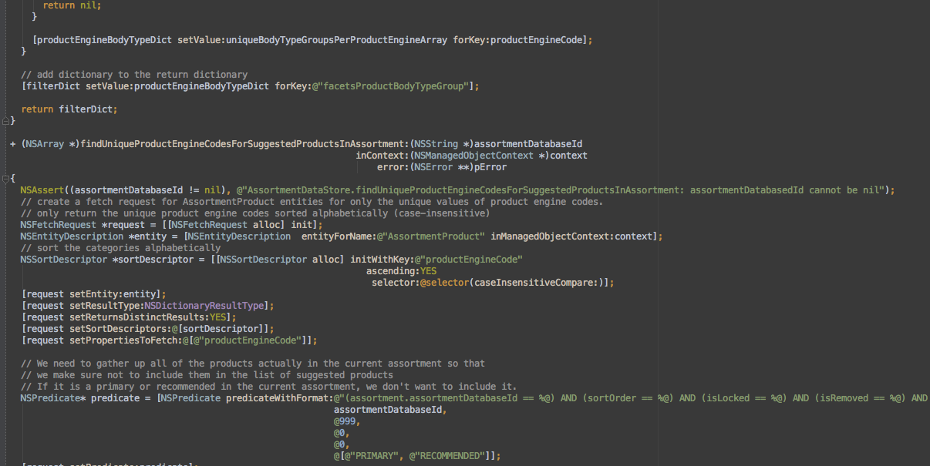
Objective-c examples
Notes:
Crack open VS2012 and AppCode to show some stuff off

Slide 34
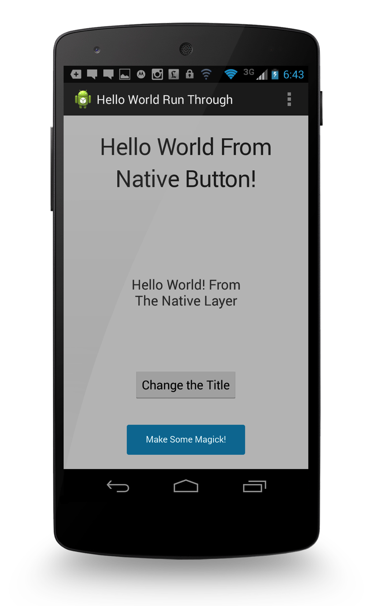
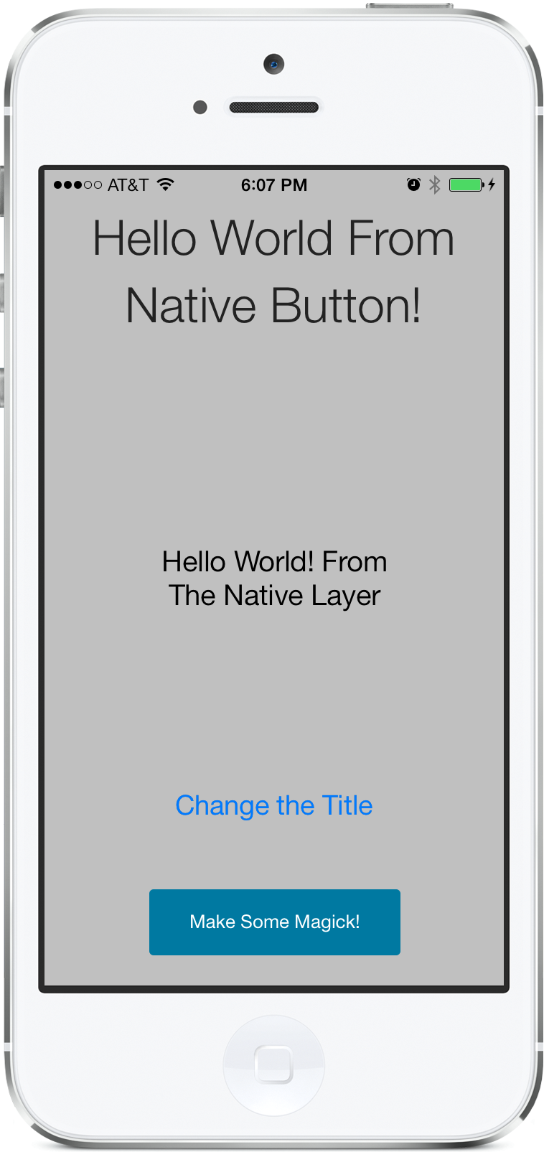

Lab: cross-platform hybrid hello world
Notes:
We assigned 60 minutes to this topic plus 30 minutes to deploy it.

Slide 35
Lab: hello world
In this lab, you will create a cross-platform hybrid Hello World app for iOS and Android. You will then deploy said app to your iOS implement.
Notes:
Lab purpose slide

Slide 36
THE hello world HYBRID STACK
HTML / CSS
ZURB FOUNDATION
HTML5
SASS / COMPASS
LIVE EDIT
JAVASCRIPT
JASMINE
REQUIREJS
SINONJS
ZEPTOJS
BACKBONE / UNDERSCORE
JQUERY
KARMA
ANGULARJS
KNOCKOUT
PHANTOMJS
iOS - OBJECTIVE-C
ANDROID - JAVA
UIWEBVIEW
WEBVIEW

Slide 37

Tools for the hello world lab
HTML / CSS
Safari
JetBrains WebStorm
Chrome
JAVASCRIPT
Safari
JetBrains WebStorm
Chrome
iOS - OBJECTIVE-C
ANDROID - JAVA
Xcode 5
Android Studio

Slide 38

Lab: hello world
Create a web project with Zurb Foundation using WebStorm
Build an iOS native container in Xcode
Build an Android native container in Android Studio, sharing the code from step 1.
Disco.
Notes:
Lab details slide
JS > Native bridge
Native > JS bridge

Slide 39


Getting from C# mv* to objective-c
Notes:
We assigned 70 minutes to this topic.

Slide 40
C# MV* => objective-c and JavaScript
What the heck did we just build?
Objective C == MVC
The ViewController
Models by way of Core Data
Notes:
Breakout here to show some examples

Slide 41

version control
Notes:
We assigned 30 minutes to this topic.

Slide 42
Project structure and version control
Xcode
AppCode and WebStorm

Slide 43
That’s enough for today.
We start again tomorrow at 8:30.

